Slide 1
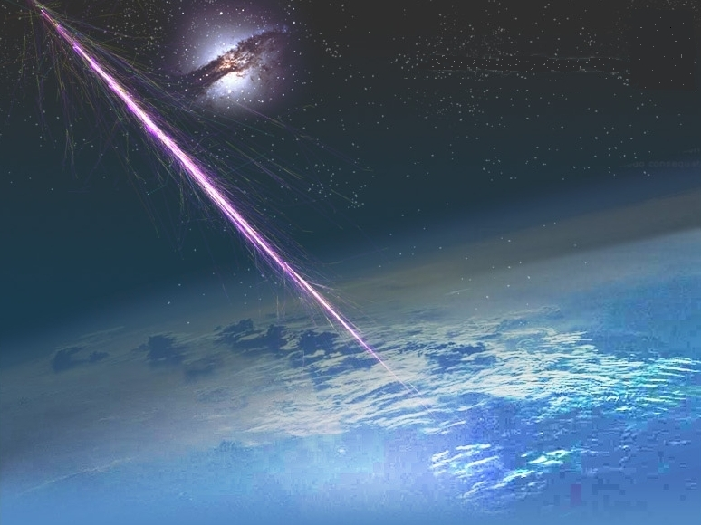
UHECR Physics
Present & Future
Tamborra Francesco Maria

Slide 2
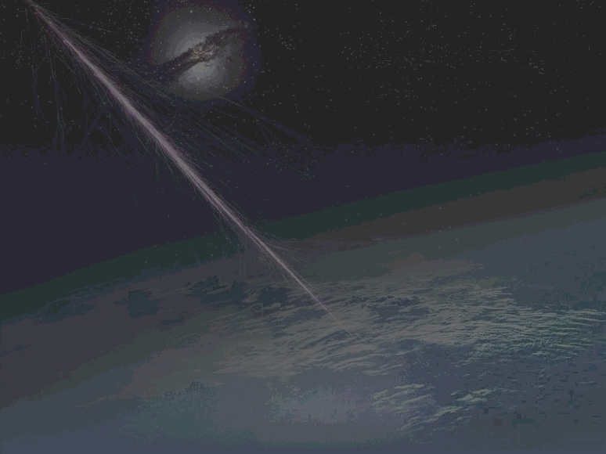
Summary
Part I
Cosmic Rays Physics
Pierre Auger Observatory:
- Scientific Objectives
- Design Features
- Observations (event selection)
- Highlight: S(1000) parameter
- Results
Part II
Pierre Auger Project Extensions:
- Pierre Auger North
- EUSO:
- Scientific Objectives
- Payload

Slide 3
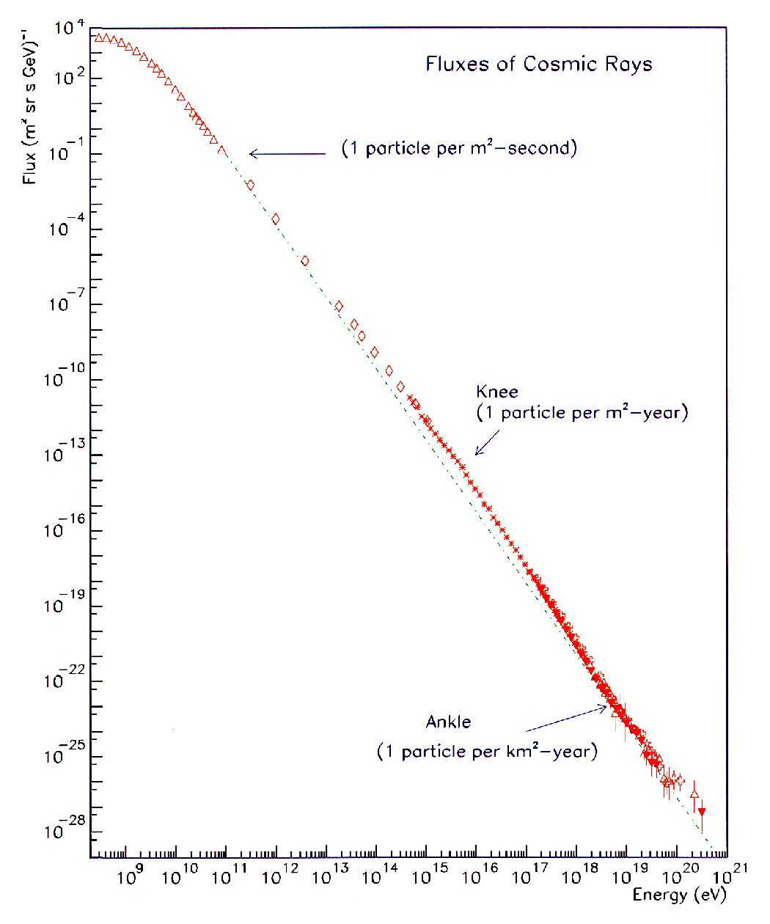
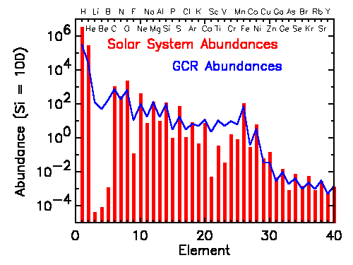
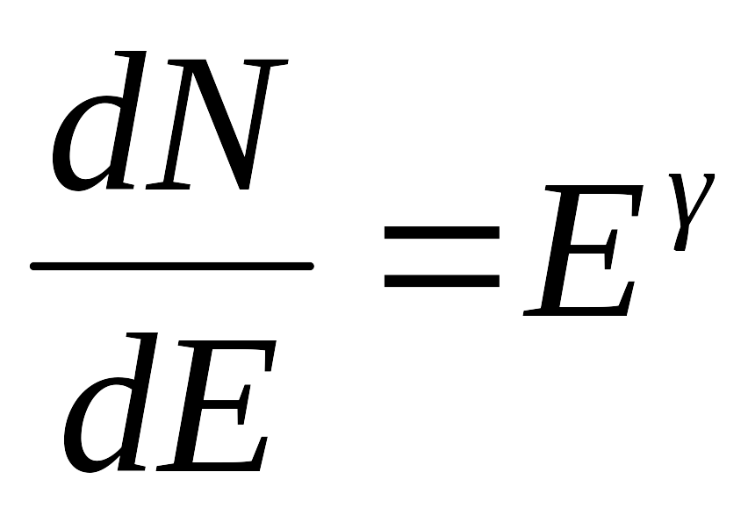
CR physics
What we KNOW
Spectrum
Composition
γ ~ 2.7 up to the knee
γ ~ 3.0 up to the ankle
γ ~ 2.7 beyond the ankle

Slide 4
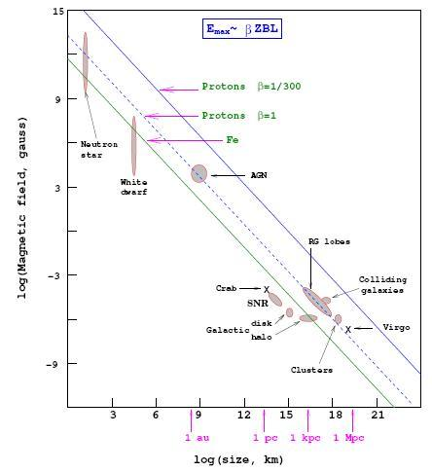
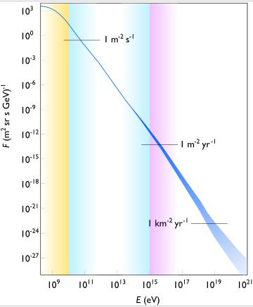
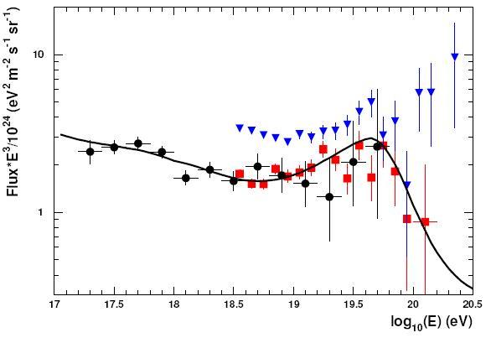
CR physics
What we DON’T KNOW
Acceleration Mechanism
Spectrum
Origin
UHE region (E>10¹⁹ eV)
Extragalactic
Galactic
Solar
Does GZK cutoff exist? (Oh-My-God Particles)
How can they reach these kinetic energies?
(a proton with E_{k}~10²⁰ eV moves at
v = 0.9999999999999999999999951 c )

Slide 5
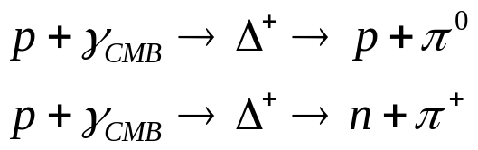
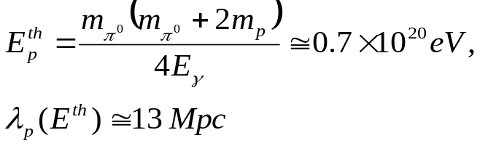
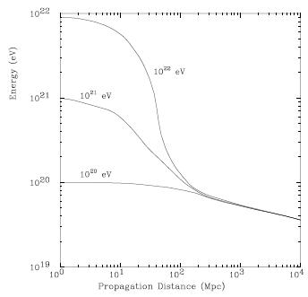
CR physics
Greisen-Zatsepin-Kuzmin effect (‘66)
Bottom-up scenario with GZK cutoff: UHECR sources are within 100 Mpc
OR
Top-down scenario:
Topological defects, relic particles,…
OR
GZK cutoff doesn’t exist!!!
Pierre Auger Observatory and its extensions will solve the puzzle…we hope!

Slide 6
PAO
Collaboration
Scientific Objectives
Argentina
Australia
Bolivia
Brazil
Czech Republic
France
Germany
Italy
Mexico
Netherlands
Poland
Portugal
Slovenia
Spain
United Kingdom
United States
Vietnam
Improve statistics above 10²⁰ eV
(10 years X 3000 Km² yelds 300-500 events)
Arrival direction distribution
UHECR composition (harder)
63 Institutions
369 Collaborators

Slide 7
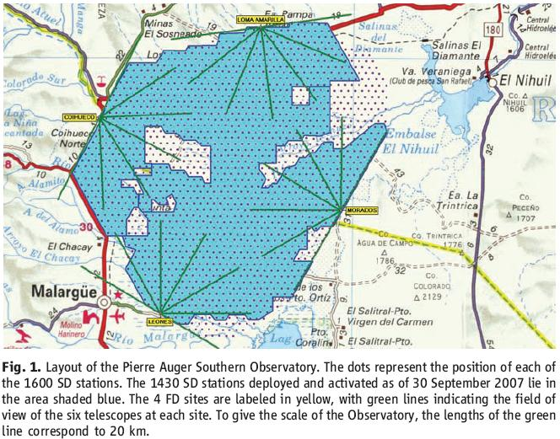
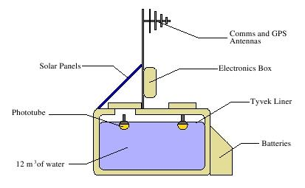
PAO
Design Features – SD Array
PMTs sampling 40 MHz (temporal resolution 25 ns)

Slide 8
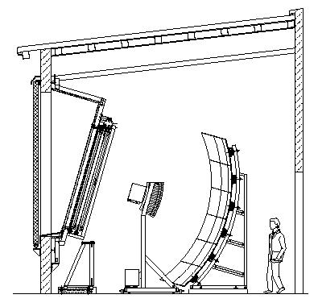
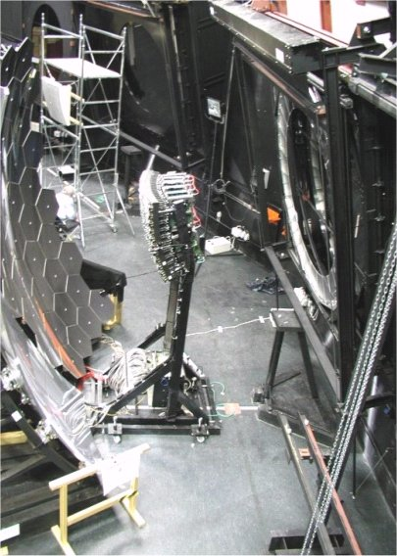
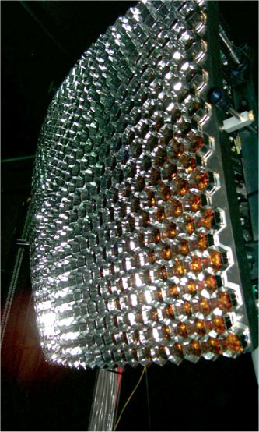
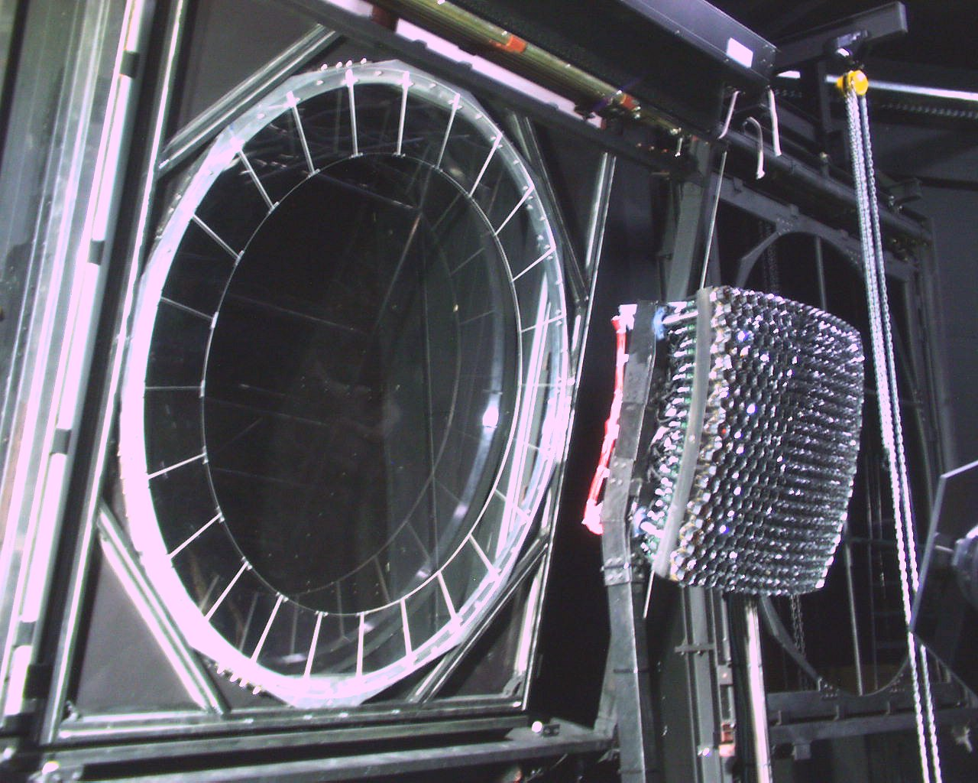
PAO
Design Features – FD
3.5 m X 3.5 m mirror
reflectivity >90%
440 PMTs each viewing 1.5° X 1.5°
Diaphram with UV filters & correctors
Field of View
30° X 30°

Slide 9
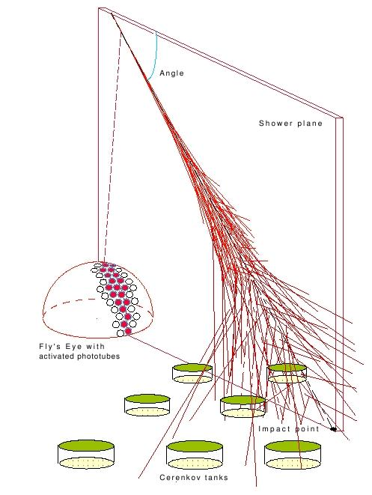
PAO
Hybrid Era
Hybrid combination advantages
In UHECR energy spectrum studies:
SD provides:
- S(1000) parameter
- huge collecting area (high statistics)
- 24h operation
FD provides:
- S(1000) to primary energy conversion rules (2-step process)
(NO calibration via hadronic interaction model dependent shower simulations)
In anisotropy studies:
High arrival direction resolution (0.6°) (thanks to small time offset between SD & FD (<50 ns))
In composition studies:
FD measures the X_{max} (indirect mass indicator)
3D shower reconstruction for hybrid events

Slide 10
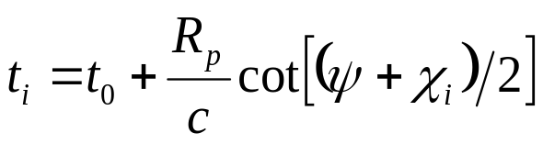
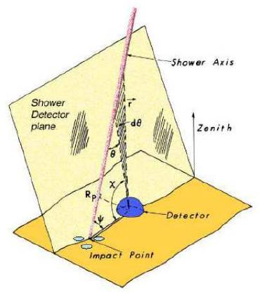
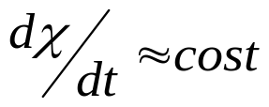
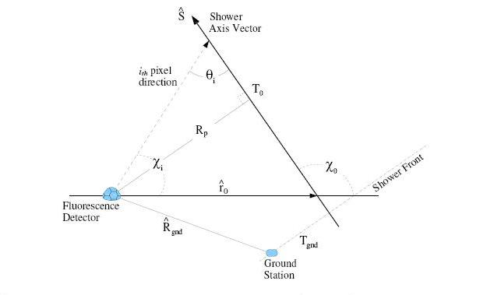
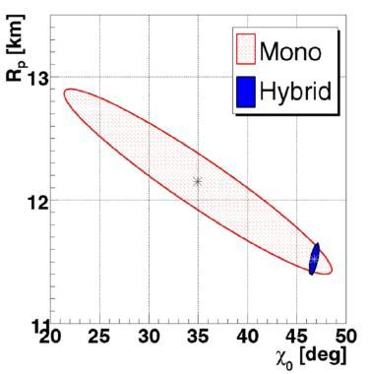
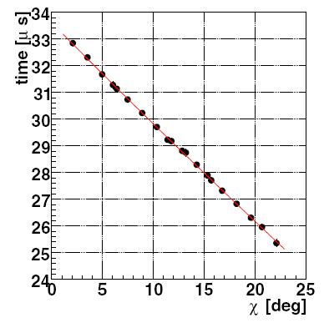

PAO
Hybrid Era
Shower Parameters

Slide 11
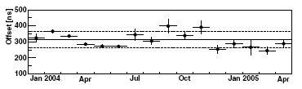
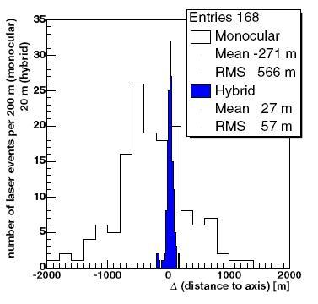
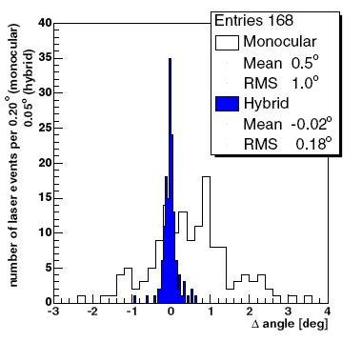
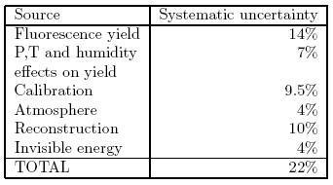
PAO
Hybrid Era
< 50 ns (< 0.6°)
Energy determination

Slide 12
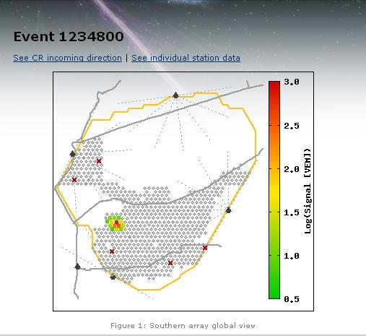
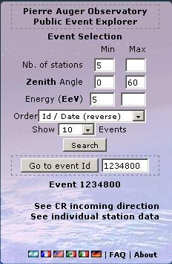
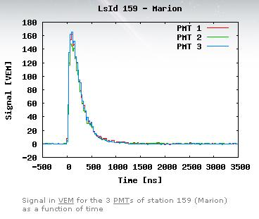
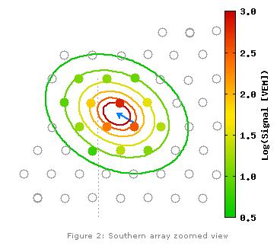
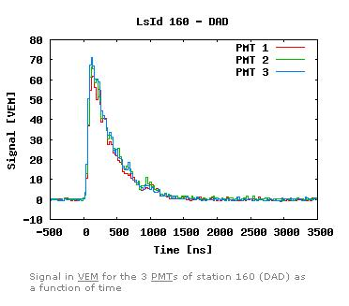
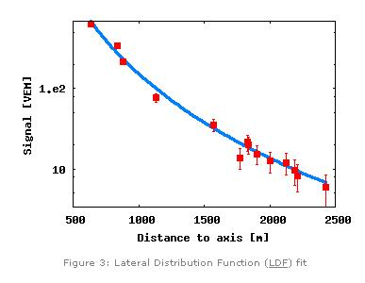
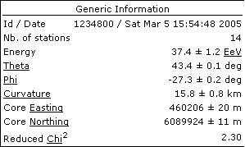
PAO
Observations

Slide 13

PAO
S(1000)
In a shower-size reconstruction Lateral Distribution Function (LDF) must be assumed
Any inaccuracies on it will lead to a corresponding inaccuracy in both:
- the location of the shower core
    the measurement of the integrated LDF (# particles)
Trough various simulations Hillas proposed to use the signal at some distance from the shower core (‘70-’71), founding the r_{opt}> 600m (Haverah Park Collaboration adopted ρ(600))
The measurement of the energy of a primary is a 2-step process:
1st) measure the signal at a particular core distance (solely dependent on the geometry of the array)
2nd) convert the signal to energy (using correlation between FD energy measurement and S₃₈)
For the first step the PAC used Monte Carlo analysis:
Geometry used
LDF:
Signal obs. @ core distance, r
Different functional forms; β is the slope
1500 m
Size parameter

Slide 14
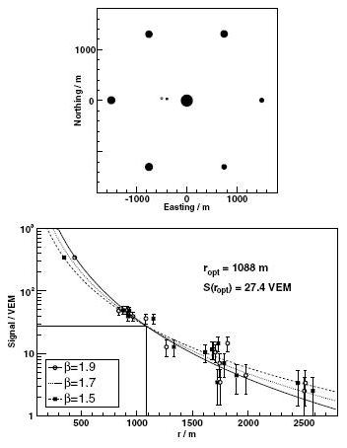
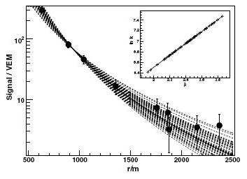
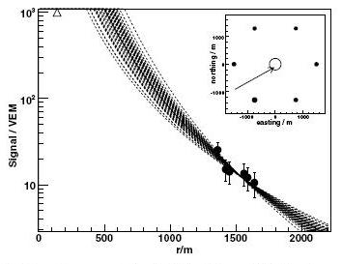
PAO
S(1000)
Reconstructing the same event 50 times with different values for β; in the inset the linear relationship between β & k, analytically expected.
It can be shown that the analytical technique is a good approximation to the numerical analysis
r_{opt} ~ 940 m
In case of saturated tank the r_{opt} moves to 1500m where the most of the signals are measured (by the 6 tanks).
(For the PAO saturations occurs for vertical signals larger than ~ 1000 VEM)
Top: reconstructed core location
Bottom: both reconstructions give reasonable fits to the signal; @ r_{opt} the same signal is measured for each reconstruction
r_{opt} ~ 1500 m

Slide 15
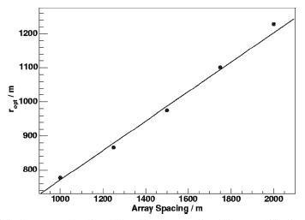
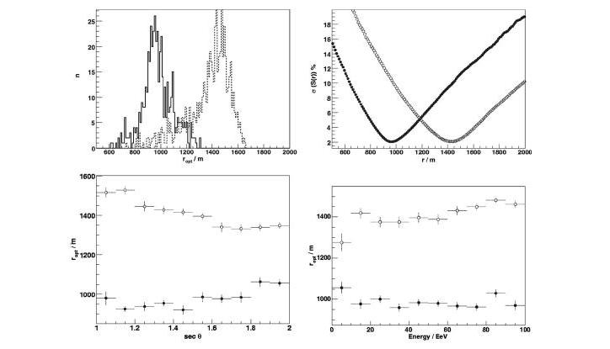
PAO
S(1000)
Analysis of 1000 showers with 0° ≤ Θ ≤ 60° and k t.c. 5 < E < 100 EeV
Variation of r_{opt} as a function of the array spacing
2 populations distribution:
the not saturated has <r_{opt}> = 970 ± 1 and RMS 102 ± 1
Corresponding mean spread in S(r); the mean systematic uncertainty is less than 2% (for saturated population is ~ 10%)
r_{opt} increases almost linearily at a rate of ~ 45 m for each 100 m increase in the detector separation
Small changes of r_{opt} with Θ and energy of the primary for both populations

Slide 16
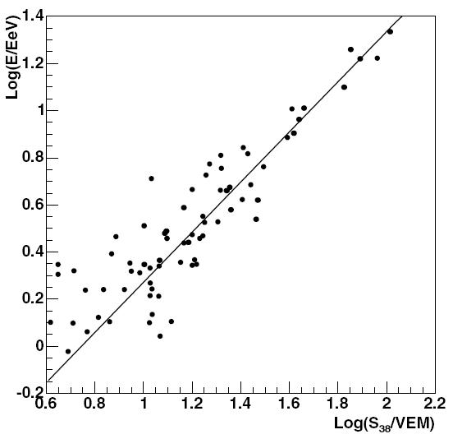
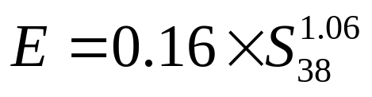
PAO
S(1000)
S₃₈ may be regarded as the S(1000) measurement the shower would have produced if it had arrived 38° from the zenith

Slide 17
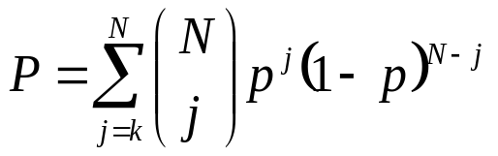
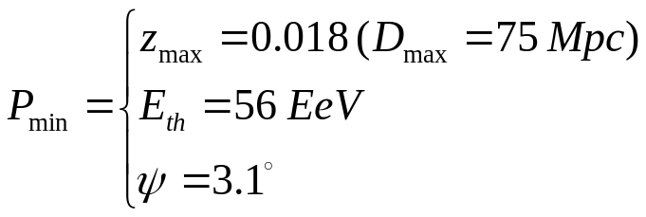
PAO
Anisotropy Results
Data set & method
V-C Catalog (85221 QSO, 1122 BL Lac, 21737 AGN)
694 have z ≤ 0.024 (D ≤ 100 Mpc)
Corr (z_{max}, ψ, E_{th})
(ψ_{min}=1° = SD resolution)
Using these parameters they found
12/15 correlated
They used data acquired between 01/01/2004 and 26/05/2006
i.e. only 3.2 events were expected to correlate by chance if the flux was isotropic
Chance correlation, p = 0.21
To avoid the negative impact of trial factors in a posteriori anisotropy searches, the PA Collaboration tested any potentially interesting anisotropy signal on an independent data set with parameters specified a priori.
The total probability of incorrectly rejecting the isotropy hypothesis was set to a maximum of 1%

Slide 18
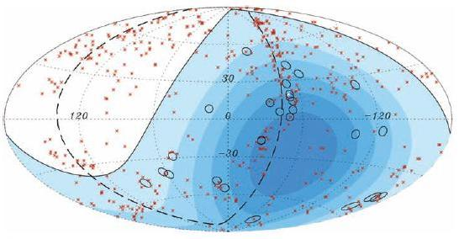
PAO
Results
Having determined that an anisotropy exist the PA Collaboration rescanned the full data set from 01/01/2004 to 31/08/2007 obtaining:
Circles of radius 3.1° centered at the 27 CR with highest energy

Slide 19
PART II

Slide 20
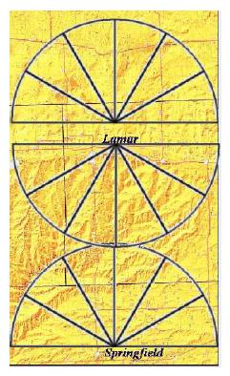
Pierre Auger North
The Northern Site project is in R&D status.
Location: Southeast Colorado, USA
Initial Area: 10370 Km² (vs 3000 Km² Southern Site; 3,3 times larger)
SD Geometry: FD Geometry:
77 Km
2.58 Km
total coverage
10370 Km²
135 Km
Improvements:
SD cost saving measure:
3 PMT 1 PMT
FADC sampling rate:
40 MHz 100 MHz
Tanks will require thermal insulation

Slide 21
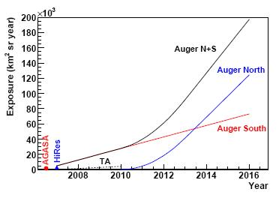
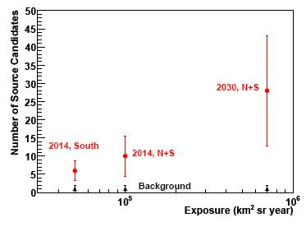
Pierre Auger North
Science

Slide 22
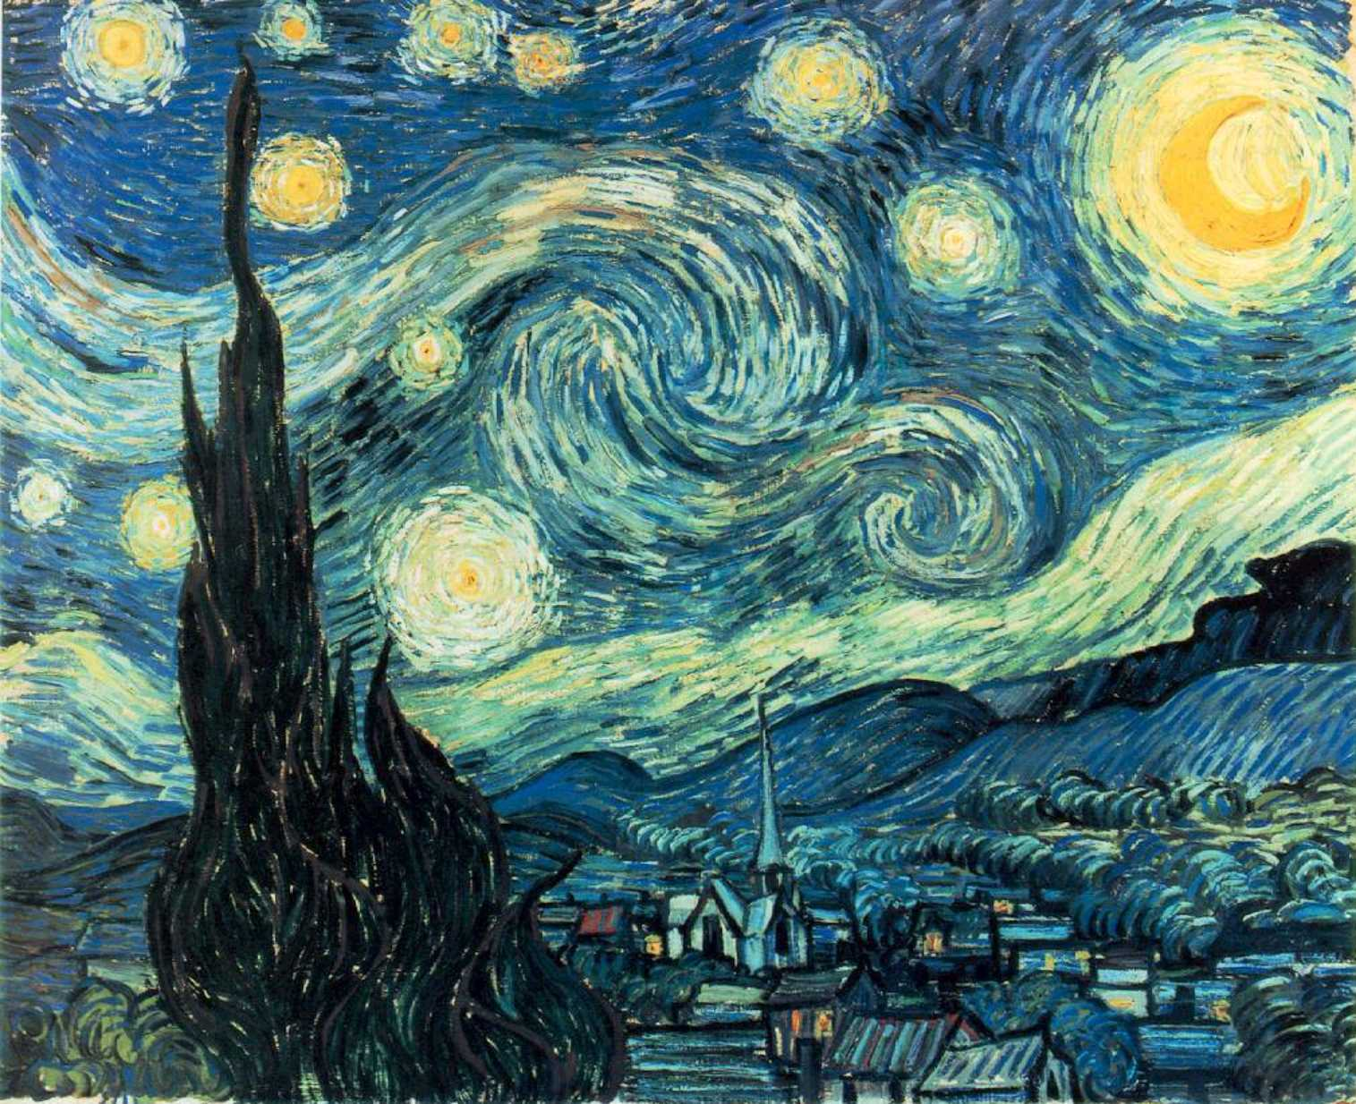

EUSO
Extreme Universe Space Observatory

Slide 23
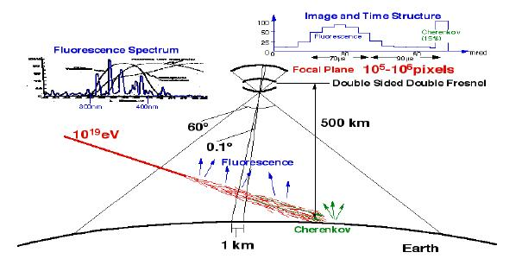



EUSO
Design

Slide 24


EUSO
Science Objectives:
UHECR statistics: 10³ events/year (10-20 times ground based exp.)
Neutrino induced EAS: Thanks to the big effective area & huge target mass
Search for transient phenomena in U-band sky: (In secondary mode) GRBs, Supernovae explosions, AGN variability,…
Physics of the atmosphere: lightning, meteor tracks, blue jets, elves,…
Performances:
Specifications
Field of view (FoV) 60° [ ~ 300 Km radius]
Angular resolution ~ 0.1° [1x1 Km]
Orbit height 380 km (~ equatorial ±10°-15°)
Operating wavelengths 337,357,391 nm
Duty Cycle 10%

Slide 25



EUSO
Neutrino Astronomy
Hypothetical Neutrino flux:
from topological defects
from Z₀ burst (ν (>ZeV) + ν_{1.9K})
from blazars
from GRB
Nearly 100% discrimination efficiency

Slide 26

EUSO
Other Science Goals
Transient Phenomena in U-band
Supernovae: EUSO will be able to monitor ~10⁶ Mpc³ with a S/N >10 in 600 s exposure. This implies 12 potential detections in one year.
Moreover, “CC-SN study” interests: late stage stellar evolution, neutrinos (rest mass problem), gravitational waves.
GRB: rarer than SNII by a factor 10⁴ but ~10³ brighter leading to the same rate of potential detections.
Monitoring in U band EUSO will be able to alert optical & radio telescope for the afterglow.
Atmosphere Physics
Phenomenon | Duration | Altitude
Elves | ~ 1 ms | ~ 100 Km
Red Sprites | ~ 10 ms | ~ 50 Km
Blue Jets | ~ 100 ms | ~ 30 Km

Slide 27




EUSO
The telescope
Optics
The optical system views a circle of radius ~ 300 Km on the Earth and resolves 1x1 Km² ground pixel
Fresnel lens provide large-aperture, wide-field system with drastically reduced mass & absorption; the drawback is a reduction in image contrast due to scattered light.
Candidate materials for the lenses:
ZEONEX (Cyclo Olefin Polymer)
TPX (Polymethylpentene)
< 2,5 m
Focal Surface Detector
~ 2x10⁵ pixels
Each macrocell consists of 6x6 MAPMT
Each MAPMT is a 8x8 anode device

Slide 28


EUSO
Consortium

Slide 29
End

Slide 30
Bibliography
Appunti del corso di Astroparticelle;
B.R.Dawson for The Pierre Auger Observatory – “Hybrid Performance of the Pierre Auger Observatory” - ICRC’07 (2007);
ESA – “EUSO – Accomodation Report” (2000);
M.Mostafà for The Pierre Auger Observatory – “Hybrid Activities of the Pierre Auger Observatory” - Nucl. Phys. B (Proc. Suppl.) 165 (2007);
D.Nitz for The Pierre Auger Collaboration – “The Northern Site of the Pierre Auger Observatory” – astro-ph/ 0706.3940v1 (2007);
D.Newton, J.Knapp, A.A.Watson – “The optimum distance at which to determine the size of a giant air shower” – astro-ph/0608118 (2007);
The Pierre Auger Collaboration – “Correlation of the Highest-Energy Cosmic Rays with Nearby Extragalactic Objects” – Science 318, 938 (2007);
The Pierre Auger Collaboration – “Correlation of the highest-energy cosmic rays with the position of nearby active galactic nuclei” – Preprint submitted to Elesevier (15 Dec. 2007)
F. Salamida – “Ultra High Energy Cosmic Rays in AUGER: Hybrid Simulation and Reconstruction” (Tesi di Dottorato, 2006);
L. Scarsi – “EUSO – A proposal for the ESA F2/F3 Flexible Missions” (1999);
Yong-Le Pan – “Multiple-anode PMT behaves like many detectors in one” – Laser Focus World
A.A.Watson – “Highlights from the Pierre Auger Observatory – the birth of the Hybrid Era” – ICRC’07 (2007);
D.Zavrtanik and D.Veberič for the Pierre Auger Collaboration – “Cosmic Rays at Extreme Energies: Status and Recent results of the Pierre Auger Observatory” - Nucl. Phys. B (Proc. Suppl.) 175-176 (2008);

Slide 31

EXTRAS

Slide 32

EXTRAS

Slide 33


EXTRAS

